Slide 1
Git’n Pro with HTML/CSS
Day 2
Month, day, year

Slide 2
I like to start with something funny…

Slide 3
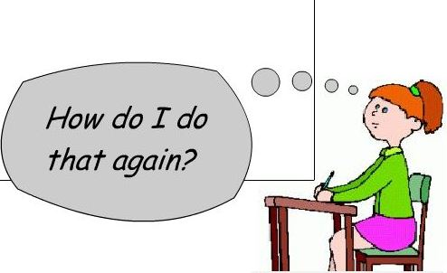
It’s Okay!

Slide 4
Admin Items

Slide 5
Where to Get Help
Practice, Practice, Practice: Work Individually or in Groups
Review In Class Material (Exercises and Slides): http://smu.bootcampcontent.com/users/sign_in (they’re in the git repo)
Re-Watch Class Videos: https://codingbootcamp.hosted.panopto.com/Panopto/Pages/Home.aspx
In Class Office Hours: 45 minutes before class, 30 minutes after
One-on-One Sessions: By Announcement through SSM
Contact Student Success: Anytime!

Slide 6
Homework #1 - Assignment
Also, at this point everyone should have access to the homework repository in GitLab. http://smu.bootcampcontent.com/users/sign_in
Homework Assignment #1 is due Saturday

Slide 7
Today’s Class!

Slide 8
Today’s Objectives
Students will understand the importance of Git Version Control and of how to use it.
Students will create GitHub Repositories, push code into them, and share with class.
Students will make more HTML documents.
Students will learn to properly use basic HTML tags.
Students will implement basic CSS styling to HTML documents.

Slide 9
Know Thyself
If you are a complete beginner to HTML/CSS and Coding:
Continue getting comfortable with HTML.
Be able to completely write a basic HTML document (like in last class).
Understand what CSS is, what it’s for, and how it works with HTML.
Be able to use Git and GitHub to upload code.
If you’ve had past exposure and felt comfortable with the last lesson:
Aim to build up your skills. Clear up any questions or confusions about HTML.
Become knowledgeable about a wider range of HTML and CSS tags.
Be able to selectively apply CSS to specific HTML elements.
Be able to use Git and GitHub to upload code.

Slide 10
What / Why Git?

Slide 11
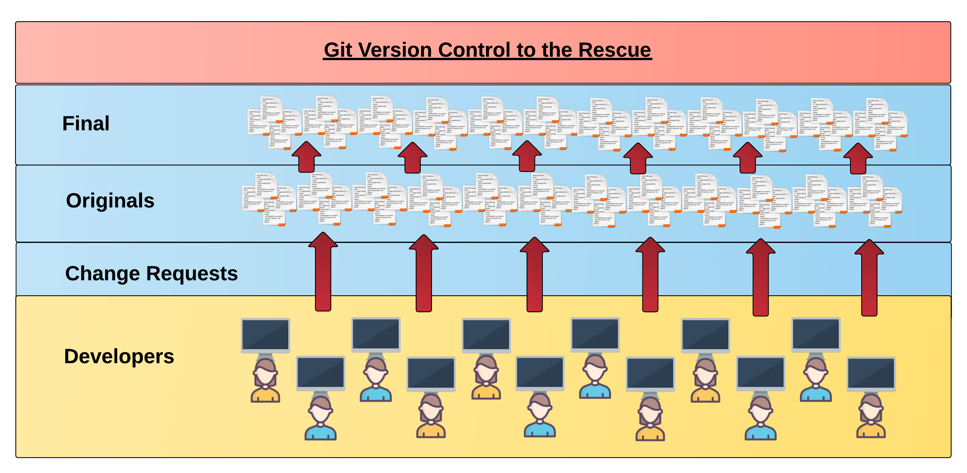
Collaborative Coding
Modern web development is highly collaborative.
Teams are often extremely large and separated across the country — or planet.
Apps sometimes comprise hundreds or even thousands of files.

Slide 12

A story…
Notes:
It is a dimension as vast as space and as timeless as infinity. It is the middle ground between light and shadow, between science and superstition, and it lies between the pit of man's fears and the summit of his knowledge. This is the dimension of imagination. It is an area which we call theTwilight Zone.

Slide 13

The Group Project
I HAZ THE GREATEST HTML IDEA!!!!!
SpongeSite.com

Slide 14

The Group Project
Programming Away…

Slide 15
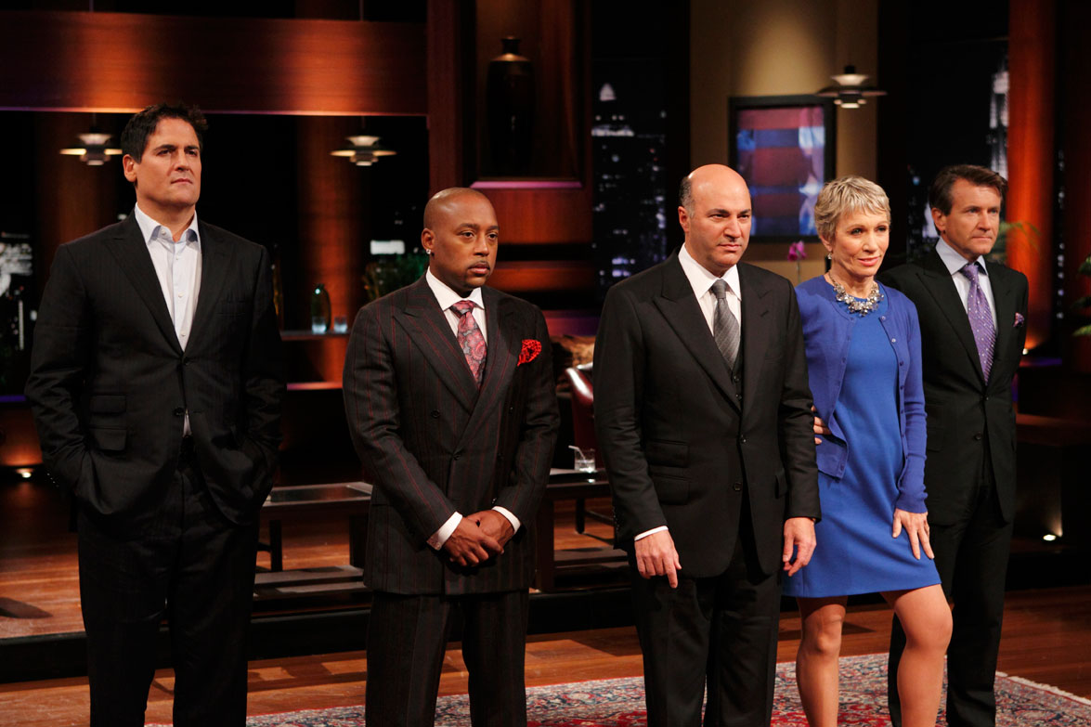
The Group Project
I just got a call from a group of potential investors. I need my site finished THIS WEEK! I’m gonna need help!

Slide 16

The Group Project
Programming Away…
Hey Bob, let me help!!! I gotz mad skillz!

Slide 17
The Group Project
Programming Away…
SpongeBob's Version
Programming Away…
Kobe’s Version

Slide 18
The Group Project
Programming Away…
Now they have two completely different versions.
Programming Away…

Slide 19
The Group Project
We love your idea! Here’s a zillion dollars but there’s a catch, it has to be live in 30 days!
Kobe and I will need more help. I know, I’ll put an ad on Craig’s List to find me a programmer to help.

Slide 20
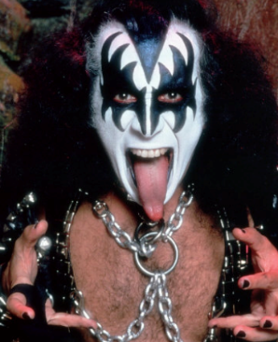
The Group Project
Programming Away…
Programming Away…

Slide 21
The Group Project
Programming Away…
Hai guyz!!!
How R Kan help??
Programming Away…

Slide 22
The Group Project – Tragedy #2
Programming Away…
OK.
<Writes terrible code>
Programming Away…

Slide 23
The Group Project
Hey, we’re in town and I know it’s unexpected, but we’d like to see what you have so far!
Oh no! Gene wrecked the site and Kobe is still trying to fix it, but I’m stuck here with the suits!

Slide 24
The Group Project
We’re in trouble! How could this have been avoided?

Slide 25
The problems so far:
Everyone is working on their own copies and someone (Bob) has to spend a lot of time merging the work together. This is time consuming and error prone, and it prevents Bob from writing code.
Kobe must constantly interact with Bob to get the latest working copy. This slows him down at a time when velocity is crucial.
Most of what Gene is doing is disruptive. If only we could vet changes before they come in, or at least back out breaking changes.
The suits showed up unexpectedly and wanted a demo, but the team were unprepared and couldn’t show one. This made the investors nervous. If only there were a way to always have a stable version of the site instantly available…

Slide 26
Version Control
Version Control: Provides a organized system for managing code for when multiple developers work on a project
at the same time.
The Benefits of Git:
You can synchronize files between developers on the team, or in the case of open source projects, the whole world.
It’s a time machine. You can go back to previous versions of the files.
You can control who is and is not allowed to send you changes, and you can vet the changes before they are allowed into your code.
It’s a perfect backup. Git stores the entire revision history on everyone’s machine.
Always have a working demo! Git allows you to take a “snapshot” (by creating a “stable” branch) of your code at points in time, so if you need to give a working copy to your boss while simultaneously tearing apart your site or app to fix something or make it better, you can.

Slide 27
Version Control
Git Init (creates a local repo)
Git Add (adds files)
Git Commit (commits the changes locally)
Set up a repo on GitHub, BitBucket, Amazon, BeanstalkApp or Google (not all of these are free)
Git Push (push local changes to GitHub)
Git clone (Copies the latest to local compute)
Make changes / add files
Git add (Stages the changes locally)
Git Commit (Commits the changes locally)
Git push (Sends their changes to GitHub)
Git pull (Syncs changes made by everyone else)

Slide 28
The Group Project
Programming Away…
Git allows you to synchronize changes using Push and Pull
Programming Away…

Slide 29
The Group Project with Version Control
Main Branch (SpongeBob's)
SpongeBob continues programming
1
2
3
4
5
Kobe pushes (uploads) his code changes into the main branch.
Code conflicts are resolved before inclusion.
Kobe’s Branch

Slide 30
The Group Project – Tragedy 2 (Revisited)
Programming Away…
OK.
Delete. Delete. Delete. Delete.
Delete. Delete
Programming Away…

Slide 31
The Group Project with version control
Main Branch (SpongeBob's)
1
2
3
4
Kiss Dude pushes his (bad) code deletions.
Kiss Dude’s Branch

Slide 32
The Group Project with version control
Main Branch (SpongeBob's)
1
2
3
4
5
But this time, SpongeBob rolls back the code to an earlier version.
Kiss Dude’s Branch

Slide 33
The Group Project
Lesson:
Use version control and you will live happily ever-after.

Slide 34
Quick Activity!
Suggested Time: 3 min
Turn to your neighbor, and have one of you explain to the other:
The concept of version control.
Then the other should explain:
Two of the key advantages to using a version control system.

Slide 35

So… What’s this GitHub?
GitHub is a Web-Based hosting service to store code online.
It allows developers to pull (download) code or push (upload) code to the same repository (directory).
It also allows developers to view histories of code changes and to track issues.

Slide 36




Pushing and Pulling to GitHub
1
2
3
4
GitHub Branch
Pull Code
Push Code
Pull Code
Pull Code
Push Code
Pull Code
Push Code

Slide 37
Get Started with Git

Slide 38
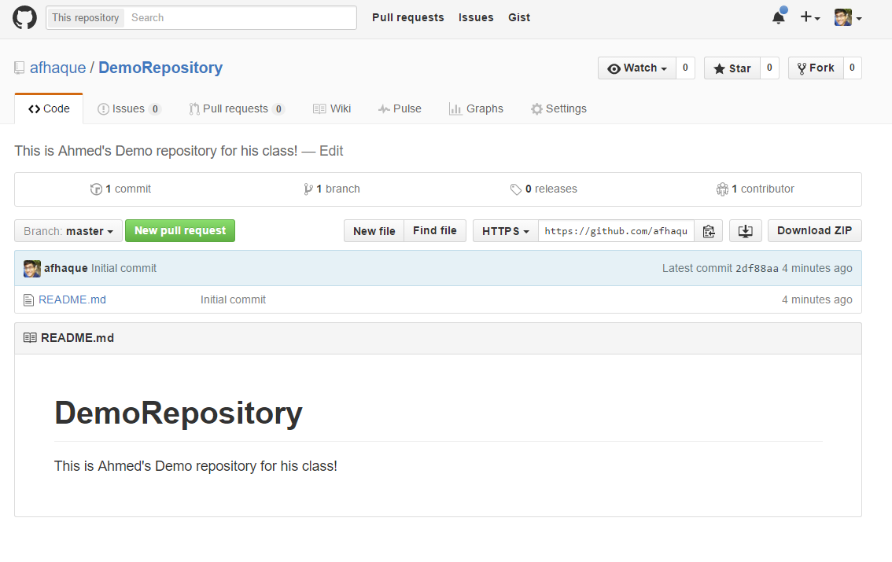
Instructor Git Demo!

Slide 39
Basic Git Commands
At its most basic, these are the five git commands to get started:
git clone
git add
git commit (include a message)
git push
git pull

Slide 40
Basic Git Commands
At its most basic, these are the five git commands to get started:
git clone – copies an entire repo (to begin).
git add – adds a file for inclusion in Git.
git commit – notes a change to the local repo.
git push – sends changes to hosting service.
git pull – downloads freshest version of repo.

Slide 41
> YOUR TURN!
Activity: Git Add, Commit, Push | Suggested Time: 20 min
Assignment:
Using GitHub and the Command Line:
Create a new public GitHub repository and name it whatever you like. Be sure to check the box for “initialize this repository with a README.”
Next, clone the repo to your local directory.
Then create an HTML file inside the local directory.
Add, Commit, and Push the code to GitHub.
Bonus:
Find a partner in class, and fork their repository to your own GitHub account. Clone this forked repository to your local directory.
Add, Commit, and Push the code back to your forked copy.
Finally, submit a pull request to send your changes to your partner’s repo.

Slide 42

Still a Bit Lost? Never Worry!
Follow this handy Guide!
Practice a few times on your own before our next class.

Slide 43
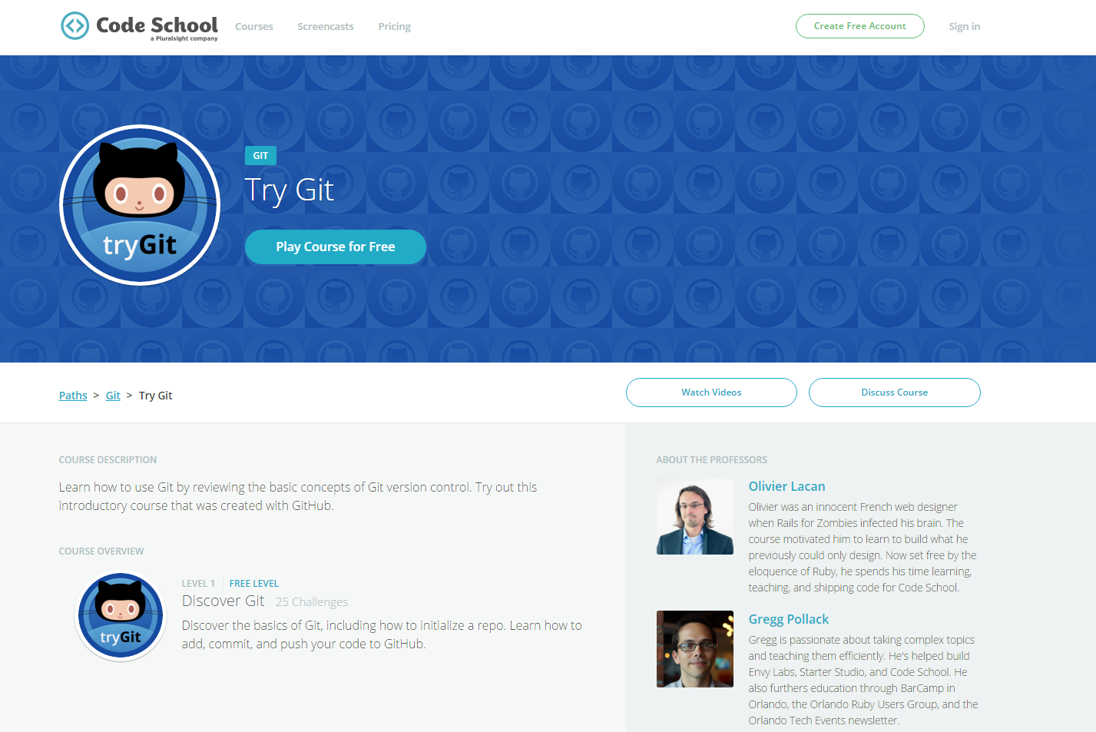
If You’re Still Lost… Here’s a (Free) Course
https://www.codeschool.com/courses/try-git

Slide 44
HTML Round 2

Slide 45
HTML Syntax (Basic)
Content
<h1>
This is Mah House
</h1>
Opening Tag
Closing Tag

Slide 46
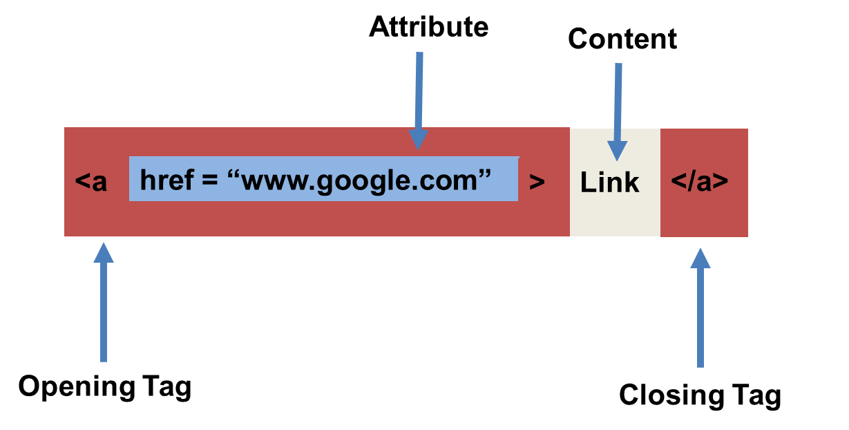
HTML Syntax (with Attribute)

Slide 47
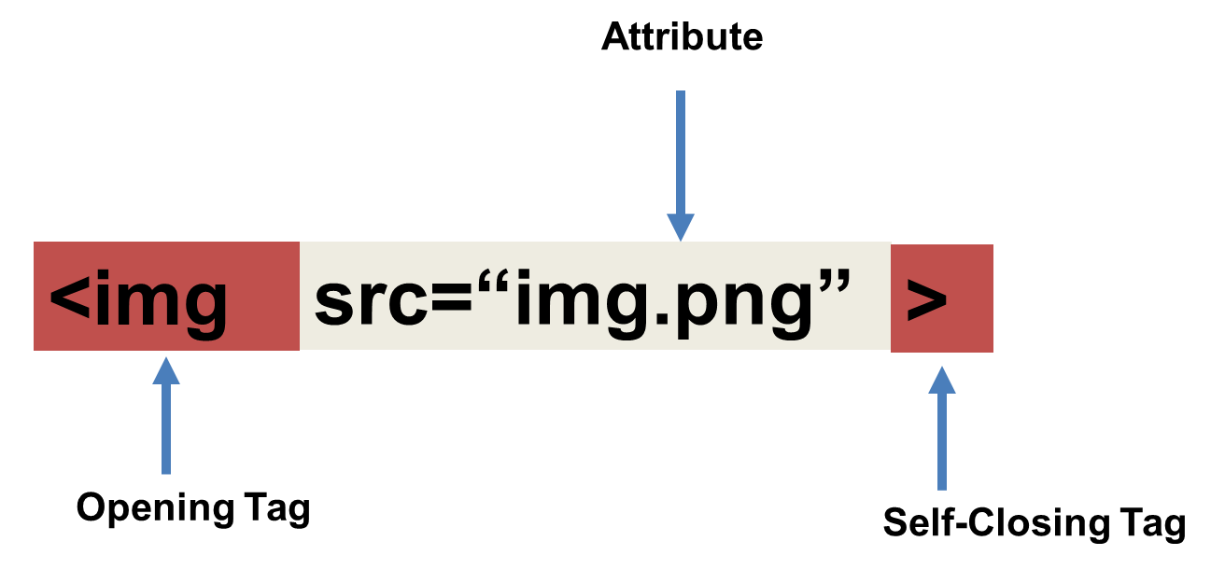
Tricky Tags (Self-Closing)

Slide 48
Important Common Tags
Headings:
<h1> </h1> - Heading 1 (Largest Heading)
<h2> </h2> - Heading 2 (Next Largest Heading)
<h3> </h3> - Heading 3
…
Containers:
<html> </html> - Wraps the entire page
<head> </head> - Wraps the header of the page
<body> </body> - Wraps the main content
<div> </div> - Logical Container ***
<p> </p> - Wraps individual Paragraphs
Others:
<strong> (bold), <em> (emphasis)
<img> (images), <a href> (links), <li> (list items) , <title> (title), <br> (line break), <table> (tables), <!-- --> (comments)

Slide 49
Less Common Tags
All HTML Tags are listed here: http://www.w3schools.com/tags/
Don’t try to memorize them! Simply refer back to documentation as needed.
Other tags:
<video> for Videos
<audio> for Audio files
<embed> for Embedded files
<code> for including computer code
<header> for headers
<nav> for navigation bars
<footer> for footers

Slide 50
HTML for Forms
Common UI (User Interface) Form Elements:
<form> - Creates a form section in HTML
<input> - Input boxes
<label> - Labels for boxes
<button> - Button
<textarea> - Large textbox

Slide 51
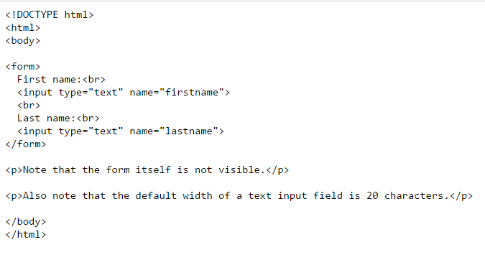
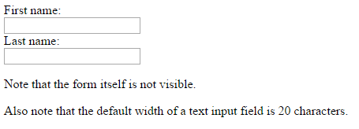
HTML for Forms

Slide 52
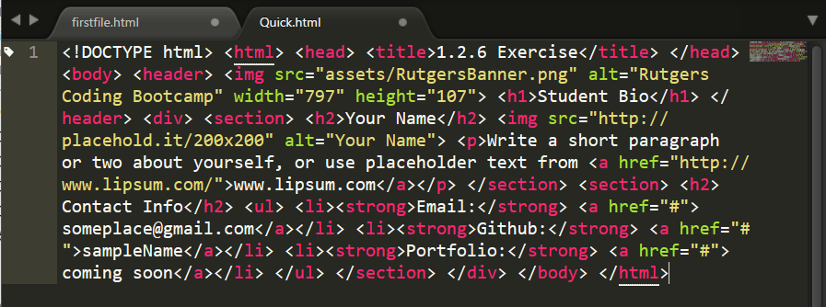
On Ugly HTML
Don’t do this… Use proper indentation and sectioning.
Readable code is easier to maintain.
Invest time to get better about this now. It will pay dividends!

Slide 53
> YOUR TURN!
Activity: 1-HTML_Git | Suggested Time: 20 min
Assignment
In this activity, you’ll create a student bio using HTML. You will then add, commit, and push your completed HTML to GitHub for the world to see.
Additional instructions, sent via Slack.

Slide 54
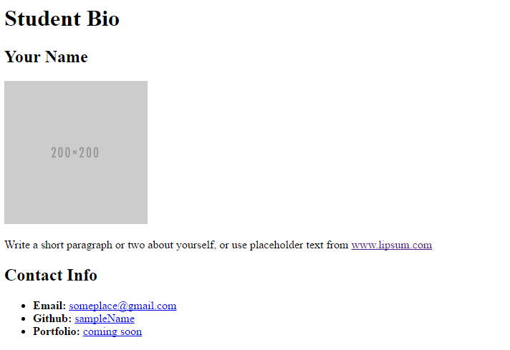
> YOUR TURN!

Slide 55
CSS Stylin’

Slide 56


HTML / CSS Definitions (*yawn* unimportant)
HTML: Hypertext Markup Language – (Content)
CSS: Cascading Style Sheets – (Appearance)
HTML/CSS are the “languages of the web.” Together they define both the content and the aesthetics of a webpage – handling everything from the layouts, colors, fonts and content placement. (JavaScript is the third – handling logic, animation, etc.)

Slide 57


HTML / CSS Analogy
HTML Alone
Like writing papers in “Notepad.”
Can only write unformatted text.
HTML / CSS
Like writing papers in Microsoft Word.
Can format text, page settings, alignment, etc. based on “highlighting” and menu options.

Slide 58
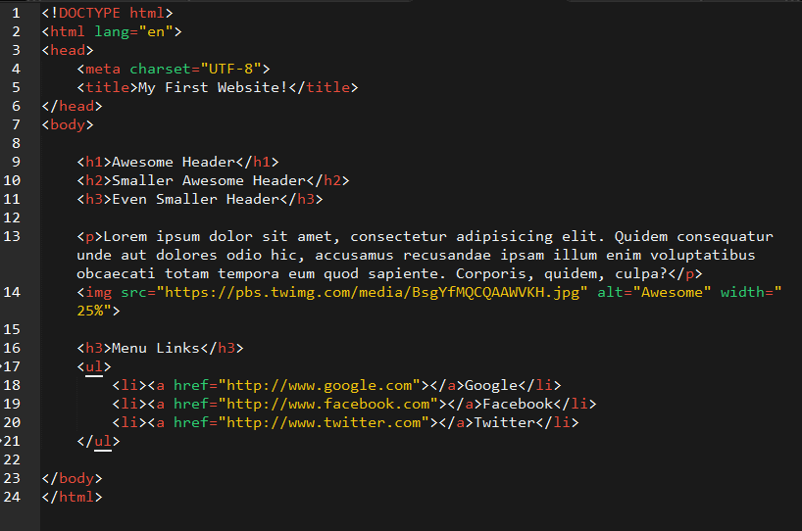
Basic HTML Page

Slide 59

Basic HTML Page - Result

Slide 60
Basic HTML Page - Result
Sooo 1992!

Slide 61
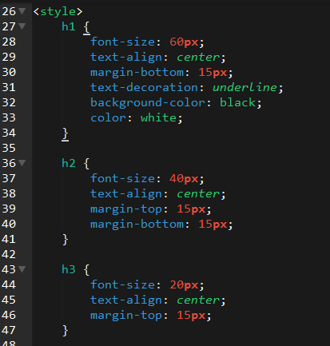
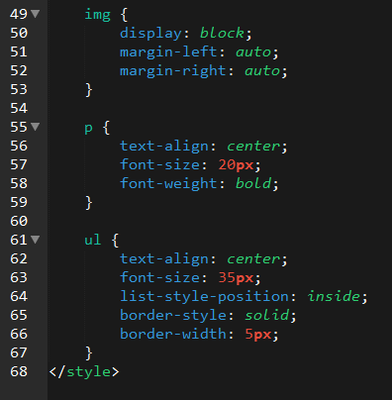
Enter CSS

Slide 62

Enter CSS - Result

Slide 63

CSS Syntax
CSS works by hooking onto selectors added into HTML using classes and identifiers.
Once hooked, we apply styles to those HTML elements using CSS.

Slide 64
CSS Example
In the below example the “Header” would be turned blue and MUCH larger because of the CSS.
We can incorporate an element’s class or ID to apply a CSS style to a particular part of the document.
Just remember to include the necessary symbol before the CSS: “.” for class, “#” for ID.
Example (HTML):
<p class=“bigBlue”>Header</p>
Example (CSS):
.bigBlue
{
font-size: 100px;
color: blue;
}

Slide 65
Key CSS Attributes
Font / Color:
color: Sets color of text.
font-size: Sets size of the font.
font-style: Sets italics.
font-weight: Sets bold.
Alignment / Spacing:
padding (top/right/bottom/left): Adds space between element and its own border.
margin (top/right/bottom/left): Adds space between element and surrounding elements.
float: Forces elements to the sides, centers, or tops.
Background:
background-color: sets background color.
background-image: sets background image.

Slide 66
Powerful Duo
Believe it or not, HTML / CSS is all you need
to develop a vivid, full-blown website.

Slide 67
INSTRUCTOR DEMO
Instructor: Demo
(quickexample_internalcss.html | 2-BasicCSS)

Slide 68
> YOUR TURN!
Activity: 3-HTML_CSS_Layout | Suggested Time: 20 min
Assignment
In this activity, you’ll upgrade your previous HTML bio-page using CSS style rules. Once you’re done, commit and push up your changes to GitHub.
We’ll send you additional instructions via Slack.

Slide 69
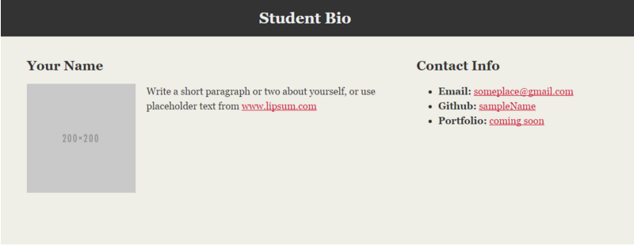
> YOUR TURN!

Slide 70
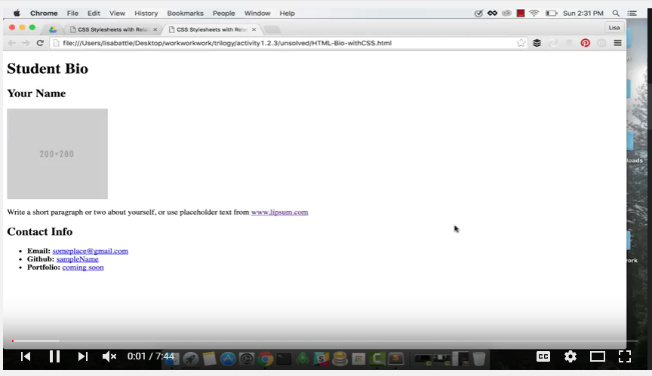
Video Walkthrough!!
https://www.youtube.com/watch?v=kMBinXTCrXI&list=PLgJ8UgkiorCnMLsUevoQRxH8t9bt7ne14&index=2

Slide 71

Still a Bit Confused?
Remember! We’ve got video guides for key activities like that last one.
If you feel like you are EVER falling behind, use those online walkthroughs to help catch back up. They are made to be easy to understand.
Still having trouble? Send your instructor or one of your TAs a message!
We are here to help you out in whatever way we can!

Slide 72
If you didn’t get it before, do you now?

Slide 73
Recap + Questions

